Slide 1
Digital Sim Feedback
What to change, screen by screen
Notes:
Feedback on the digital sim build. Every screenshot after slide 2 was taken at the zoomed size.

Slide 2
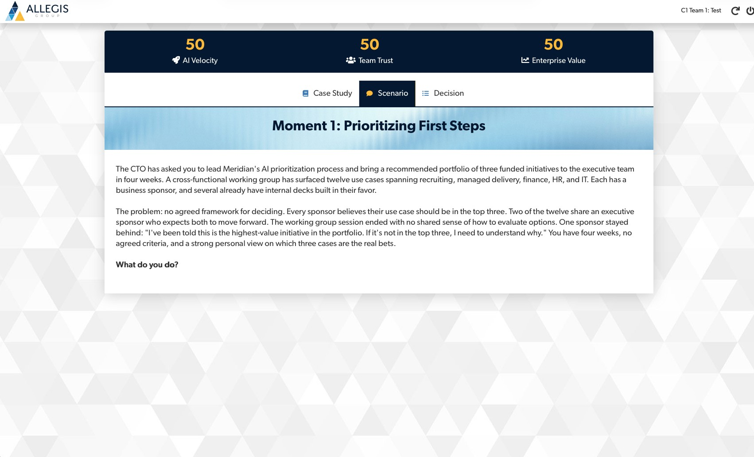
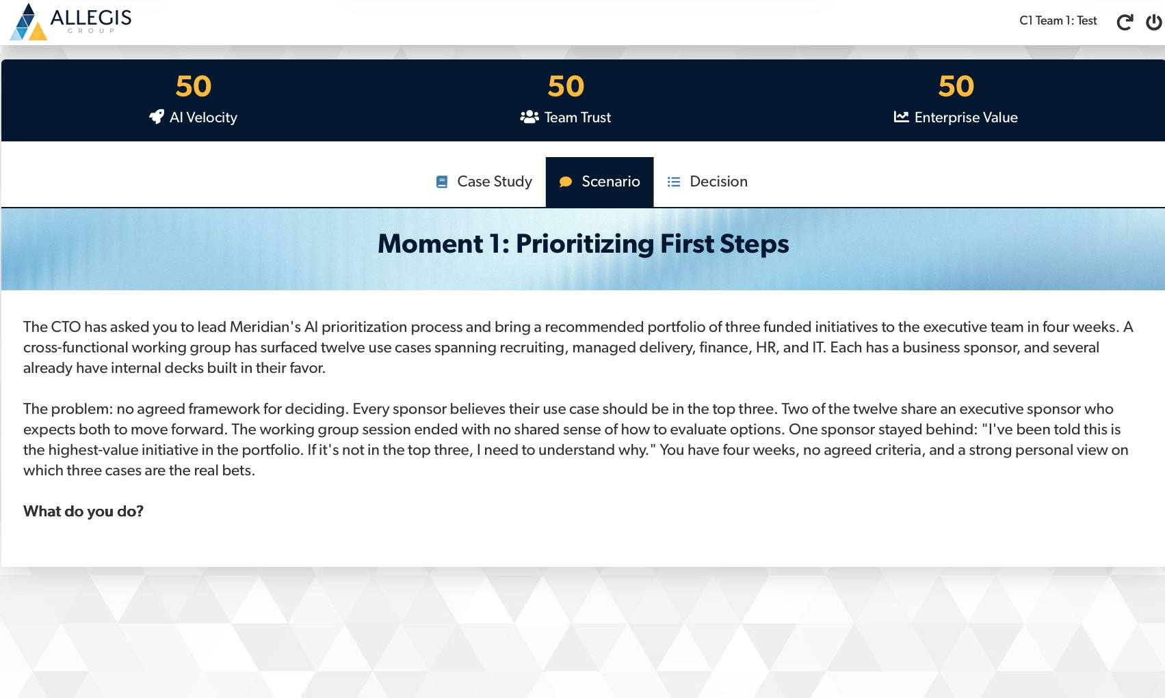
Make everything bigger
1
Digital (13-Oct): Done
Now
Zoomed in (use this as the new default)
Increase the size of everything: the logo, team name, buttons, and all text.
Notes:
Both screenshots show the same page. The second was taken with browser zoom increased. All later screenshots use the zoomed size.

Slide 3

Team name page: much, much bigger
2
Digital (13-Oct): Done
The text is tiny.
Enlarge the heading, the name field, the character counter, and the button.

Slide 4
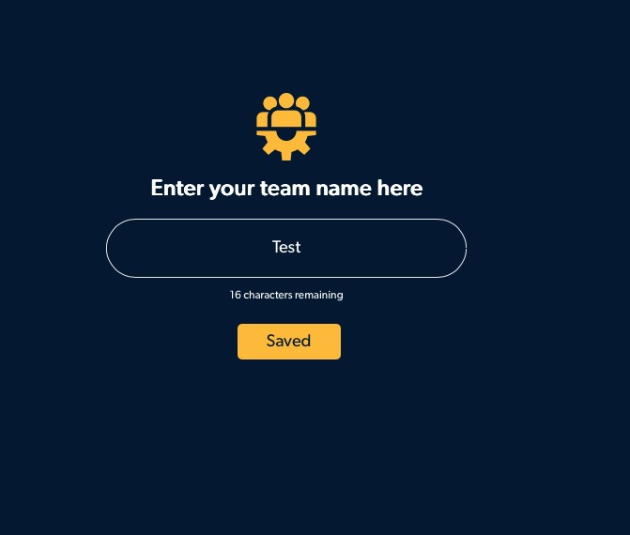
After submit: add a thank-you message
Digital (13-Oct): Done
3
Thank you!
Sit tight. Your facilitator will move everyone forward once all teams have submitted their names.
Suggested wording shown in the pop-up. Show it right after the team name is saved.

Slide 5
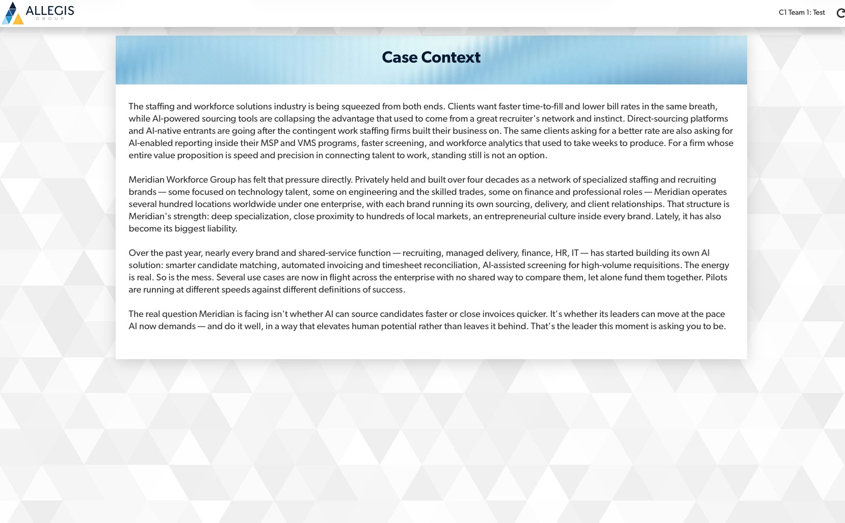


Case study: break up the wall of text
Digital (13-Oct): Done
4
Add an image here
A varied group of men and women working together in an office with greenery
Break up the text with an image. Show a mix of men and women so the group feels diverse. See examples for inspiration.
Notes:
The generated image is shared in chat. Drop it into the placeholder on the right. The first two images we saw only showed women, so this one should mix men and women.

Slide 6
Moment scenarios: add an image to each
Digital (13-Oct): Done
5
Every Moment scenario needs an image.
Moments 1 to 4, plus the new information page.

Slide 7
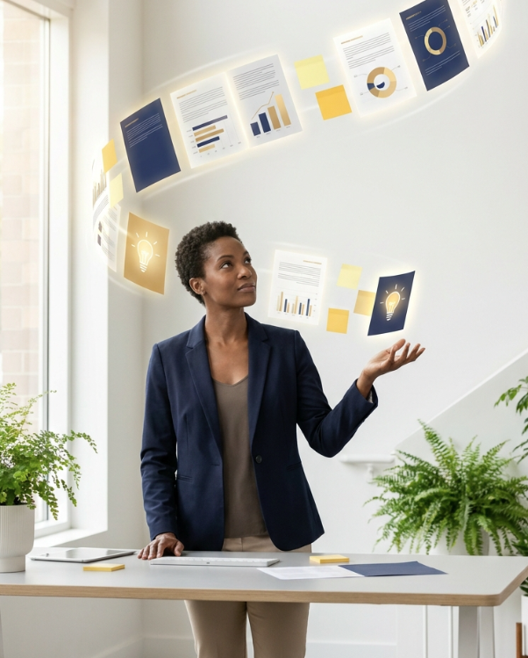


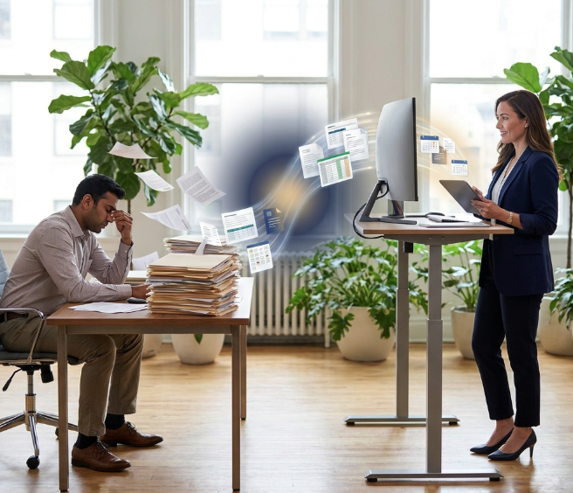
Example ideas for moment images
Digital (13-Oct): Done

Slide 8

Submit and Saved buttons: change color
Digital (13-Oct): Done
6
Now
After a click (example)
Saved
Change the color once it is clicked, so teams can see it worked. Example: yellow, then green.
Notes:
The Saved button already reads Saved before anything is saved on the team name page. A color change would help, and the label may need to change too.

Slide 9
Add the split-screen look elsewhere
9
Digital (13-Oct): Please suggest which screen would you like us to update.
We could not find/identify any screen on the facilitator side where this split-screen photo style can be applied.
We love this
Use the split-screen photo style on the facilitator screens for a bit of visual variety.

Slide 10
DEV TEAM
DIGITAL TEAM CAN IGNORE
Notes:
Feedback on the digital sim build. Every screenshot after slide 2 was taken at the zoomed size.

Slide 11
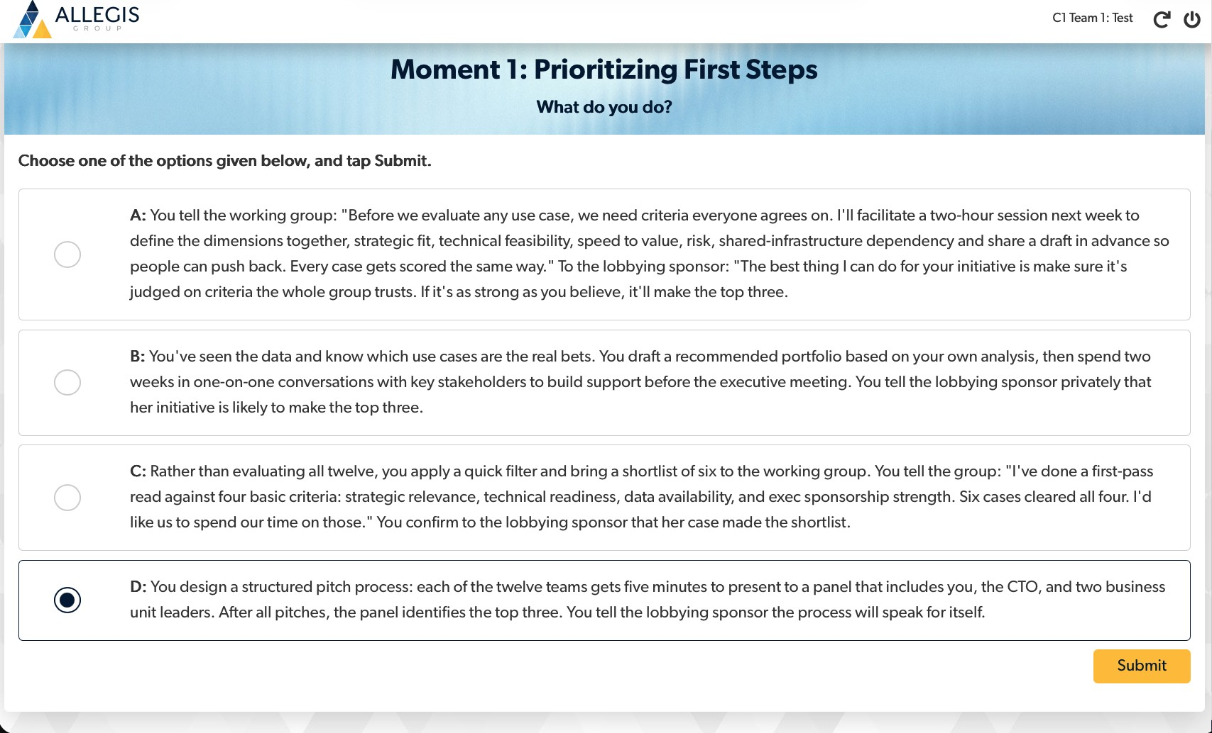
For Kevin: equalize the Moment text
7
Kevin, as you review text (you mentioned simplifying) aim to equalize the length. Option A runs 4 lines. Option D runs 2. Simplify each one.
Notes:
I know you were already planning to simplify the options. This is just the written note.

Slide 12
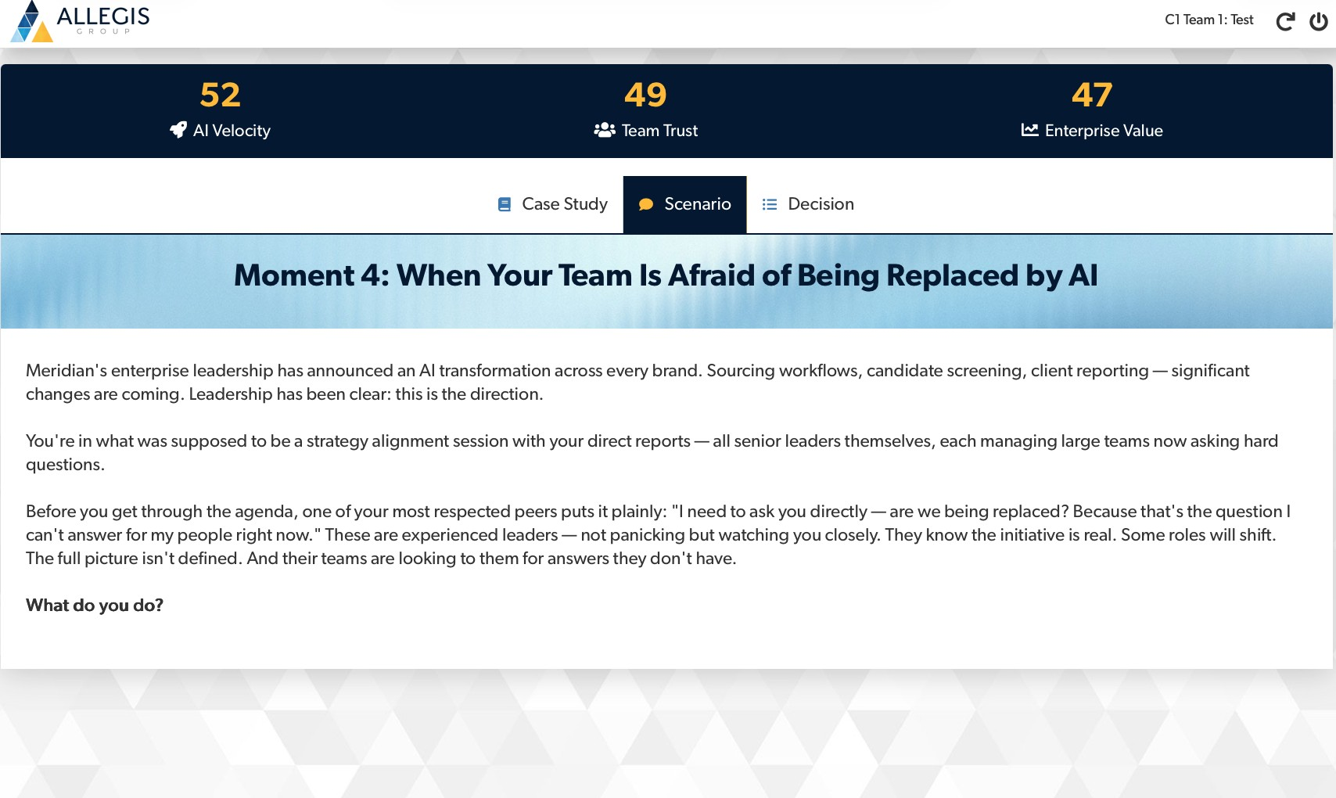
Remove em dashes throughout
8
Recommend to remove every em dash.
They show up in the case study, scenarios, options, and feedback text.

